Slide 1
Agile EA Defined

Slide 2
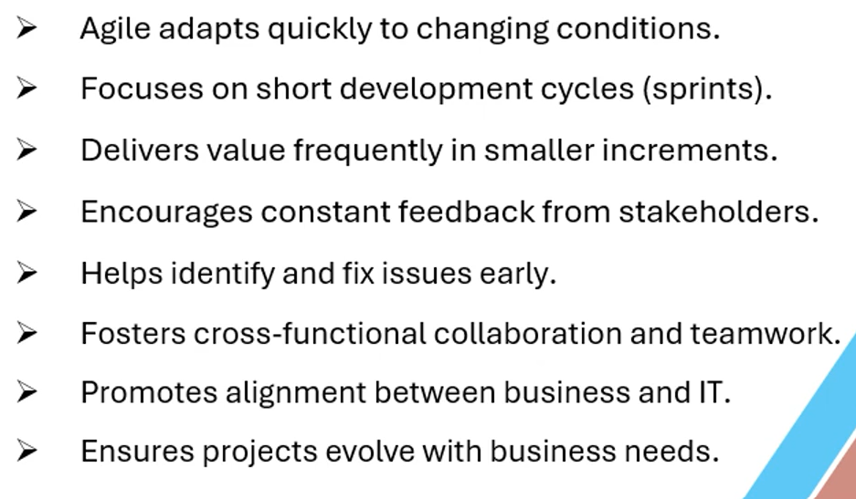
Why Agile ?

Slide 3
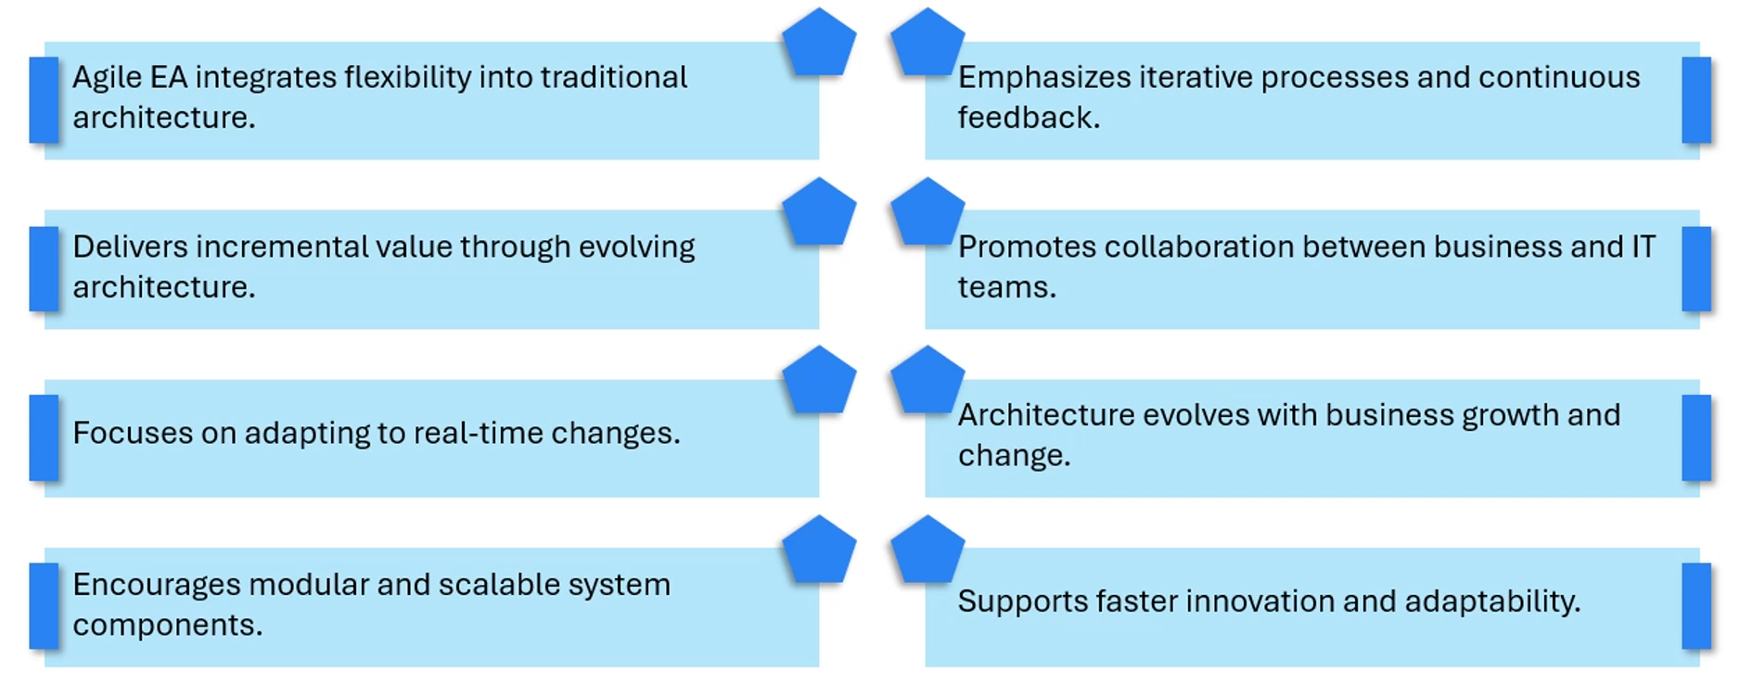
Agile EA Defined

Slide 4
Thank you

